Slide 1
Tree-Structured Indexes
SUN YAT-SEN UNIVERSITY

Slide 2
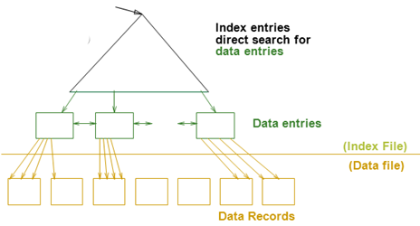
Review
Cost Model（代价模型）
  只关心磁盘块的IO次数
    文件由页组成，而每个页包含一组记录
    Record id = <page id, slot #>
    从随机访问的角度来说，读写一条记录需要一次磁盘IO。
索引技术概述
  可以为关系建立索引，都是文件
  索引文件由两部份组成
    数据项部分
      Data Entry(数据项) data record（数据记录）
    引导部份
      树索引技术
      Hash索引

Slide 3
Tree-Structured Indexes: Introduction
Tree-structured indexing techniques support both equality selections and range selections.
  ISAM(索引顺序存取方法): static structure; early index technology.
  B+ tree: dynamic, adjusts gracefully under inserts and deletes.
Notes:
2

Slide 4
Range Searches
``Find all students with gpa > 3.0’’
  If data is in sorted file, do binary search to find first such student, then scan to find others.
  Cost of binary search in a database can be quite high.
    Why???
Simple idea: Create an `index’ file.
索引项 <search key value of first record, page id>
k₁
k₂
k_{N}
Index File
分隔符
(…, k₁)
[k₁, k₂)
[k₂, …)
[k_{N}, …)
Page 1
Page 2
Page 3
Page N
排序的 Data File
Can do binary search on (smaller) index file!
Notes:
3

Slide 5
ISAM
index entry（分隔符）
P
K
P
K
2
P
K
P
m
0
1
1
2
m
(…, k₁)
[k₁, k₂)
[k₂, …)
[k_{m}, …)
Index file may still be quite large. But we can apply the idea repeatedly!
索引树：节点=Page
Non-leaf
Pages
Leaf
Pages
Overflow
page
Primary pages
Leaf pages contain data entries.
Notes:
4

Slide 6
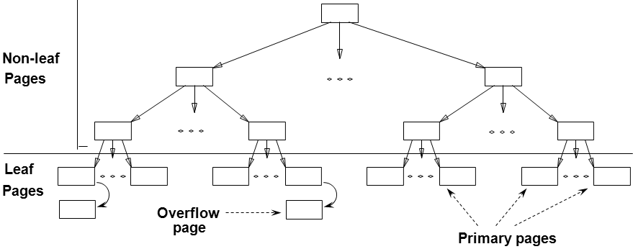
ISAM is a STATIC Structure
Data Pages
File creation:
  Leaf (data) pages allocated sequentially, sorted by search key
  then index pages
  then overflow pgs.
Search: Start at root; use key comparisons to go to leaf.
Cost = log _{F} N
  F = # entries/page (i.e., fanout 扇出)
  N = # leaf pages
  no need for `next-leaf-page’ pointers. (Why?)
Insert: Find leaf that data entry belongs to, and put it there. Overflow page(溢出页) if necessary.
Delete: Seek and destroy! If deleting a tuple empties an overflow page, de-allocate it and remove from linked-list.
Index Pages
Page Number
Overflow pages
Static tree structure: inserts/deletes affect only leaf pages.
Notes:
5

Slide 7
Example ISAM Tree
Example where each node can hold 2 entries;
Index entries: <search key value, page id>, they direct search for data entries in leaves.
分隔符
Root
40
(…, 40)
[40, …)
20
33
51
63
[33, …)
[63, …)
(…, 20)
[20, 33)
(…, 51)
[51, 63)
10*
15*
20*
27*
33*
37*
40*
46*
51*
55*
63*
97*
Notes:
6

Slide 8
Example: Insert 23*, 48*, 41*, 42*
分隔符
Root
Index
40
Pages
(…, 40)
[40, …)
20
33
51
63
(…, 20)
[33, …)
(…, 51)
[63, …)
Primary
[20, 33)
[51, 63)
Leaf
10*
15*
20*
27*
33*
37*
40*
46*
51*
55*
63*
97*
Pages
Overflow
23*
48*
41*
Pages
42*
Notes:
7

Slide 9
... then Deleting 42*, 51*, 97*
分隔符
Root
Index
40
Pages
(…, 40)
[40, …)
20
33
51
63
(…, 20)
[33, …)
(…, 51)
[63, …)
Primary
[20, 33)
[51, 63)
Leaf
10*
15*
20*
27*
33*
37*
40*
46*
51*
55*
63*
97*
Pages
Overflow
23*
48*
41*
Pages
42*
ISAM is a STATIC Structure
Note that 51 appears in index levels, but not in leaf!
Notes:
7

Slide 10
B+ Tree Structure
Each node contains d <= m <= 2d entries (index or data)
  The parameter d is called the order(秩) of the tree.
  Each internal node contains m index entries: <key, page id>.
  Each leaf node contains m data entries: <key, record or record id>
The ROOT node contains between 1 and 2d index entries.
  It is a leaf or has at least two children.
Each path from the ROOT to any leaf has the same length.
- 平衡树 -- 树的高度
Supports equality and range-searches efficiently.
Index Entries
(Direct search)
Data Entries
("Sequence set")
Notes:
9

Slide 11
B+ Tree Equality Search
Search begins at root, and key comparisons direct it to a leaf.
Search for 15*…
分隔符
Root
13
17
24
30
2*
3*
5*
7*
14*
16*
19*
20*
22*
24*
27*
29*
33*
34*
38*
39*
Based on the search for 15*, we know it is not in the tree!
Notes:
10

Slide 12
B+ Tree Range Search
Search all records whose ages are in [15,28].
  Equality search 15*.
  Follow sibling pointers.
分隔符
Root
13
17
24
30
2*
3*
5*
7*
14*
16*
19*
20*
22*
24*
27*
29*
33*
34*
38*
39*
Notes:
10

Slide 13
B+ Trees in Practice
d <= m <= 2d
Typical order (秩) : 100. Typical fill-factor: 67%.
  average fanout(扇出) = 133 2d*2/3
  Level 1 = 1 page = 8 KB
  Level 2 = 133 pages = 1 MB
  Level 3 = 17,689 pages = 145 MB
  Level 4 = 2,352,637 pages = 19 GB
Can often hold top levels in buffer pool:
With 1 MB buffer, can locate one record in 19 GB (or 0.3 billion records) in two I/Os!

